Slide 1
ProQuest User Guide
Laurus College

Slide 2
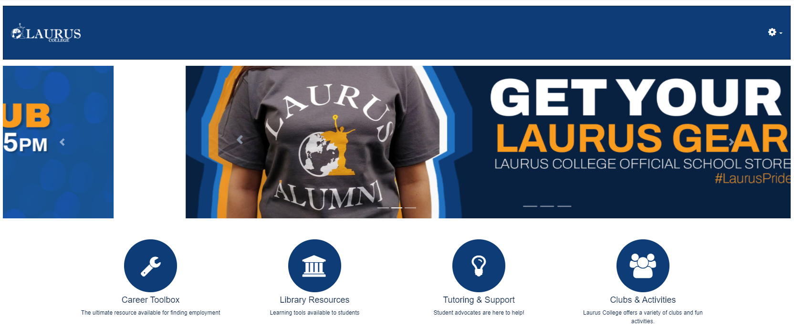
From the main MLP page click on the “Library Resources” area in the middle of the page.

Slide 3
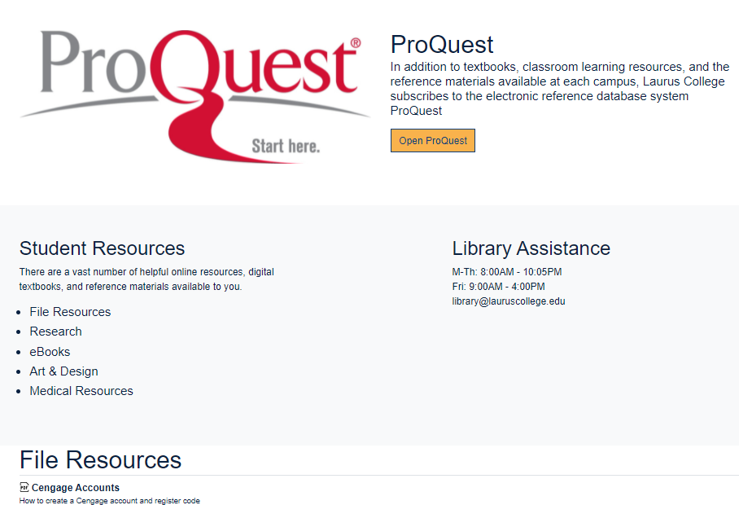
Next click the “Open ProQuest” button.

Slide 4
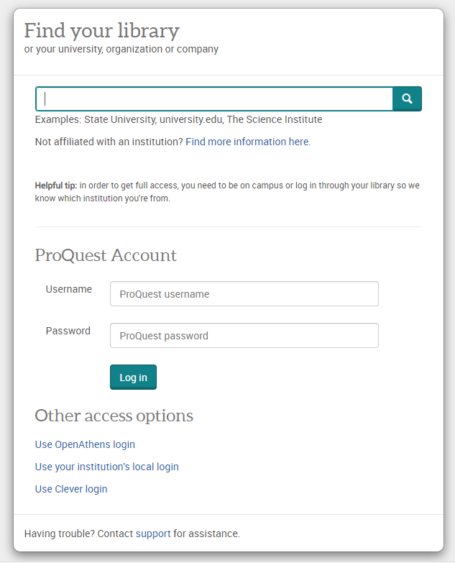
In the ProQuest Account section at the bottom enter the following to log in.
Username: laurusproquest
Password: welcome
The click “Log in”

Slide 5
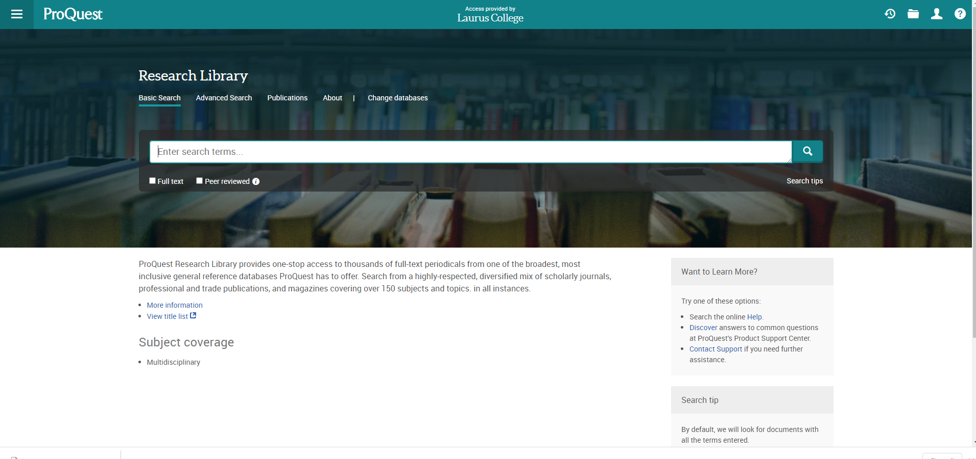
Enter your search criteria in the “Enter search term” text box.

Slide 6
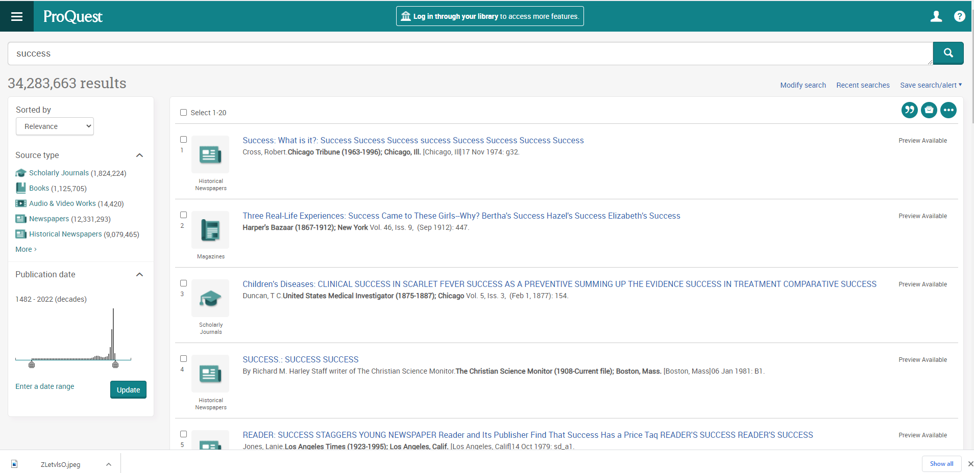
Here are the results searching “Success”. Select a result to view the resources or select a specific source type by choosing an option in the left column.

Slide 7
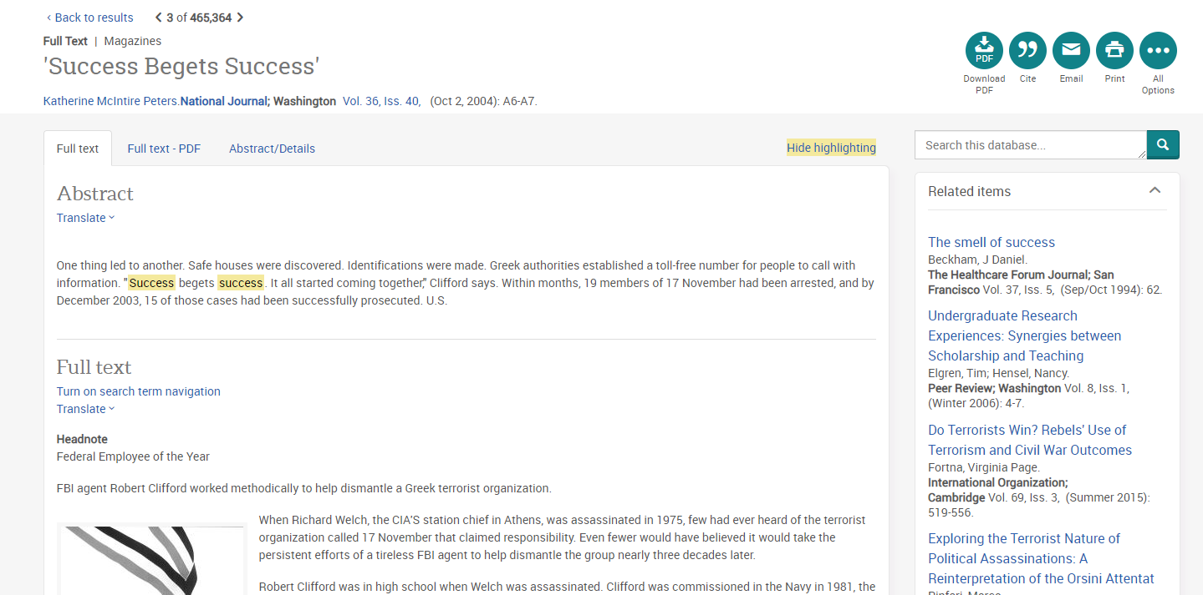
Read the summary of the resource or select the “Full text – PDF” to view the entire resources.
Click the “Cite” button in the top right to get the properly formatted reference for your paper.

Slide 8
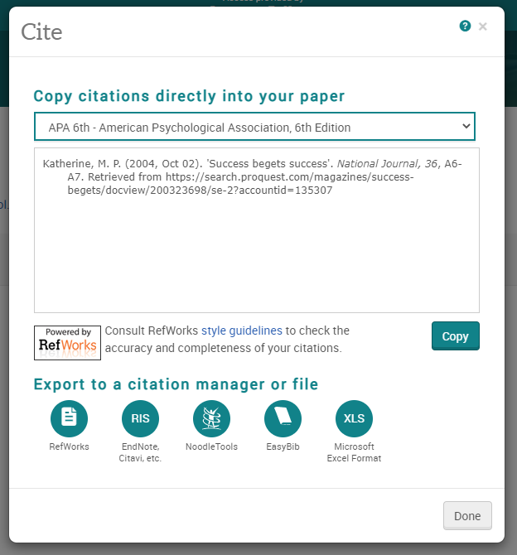
Choose you citation style for the dropdown.
Copy citation and paste on the last page of your paper.

